Slide 1
Reliable Real-time Lip Reading
with no sound and minimal ado

Slide 2
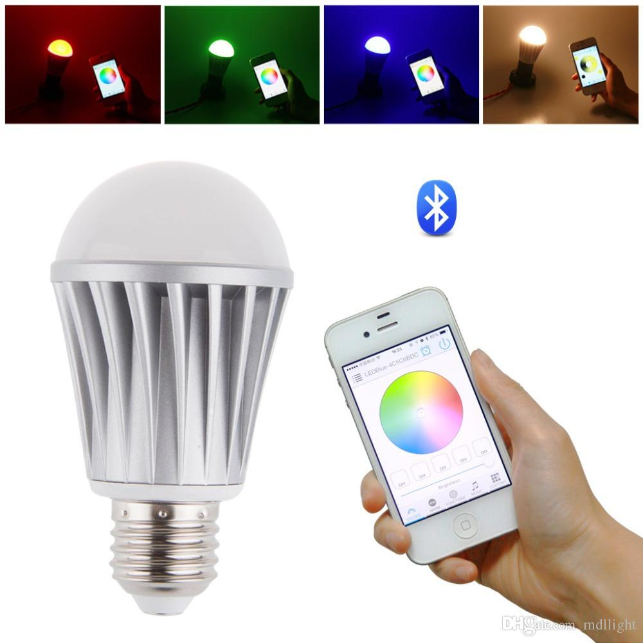
wasn’t quite sure what to do with this birthday present

Slide 3
Apps take too long to open

Slide 4
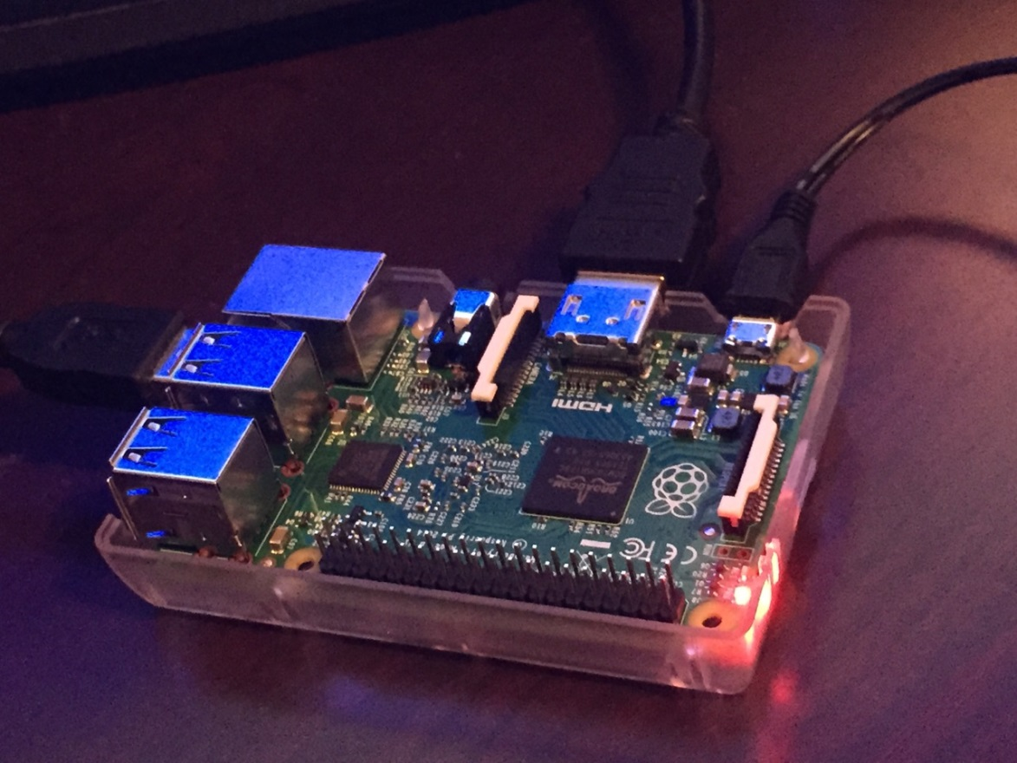
I am not a computer person

Slide 5

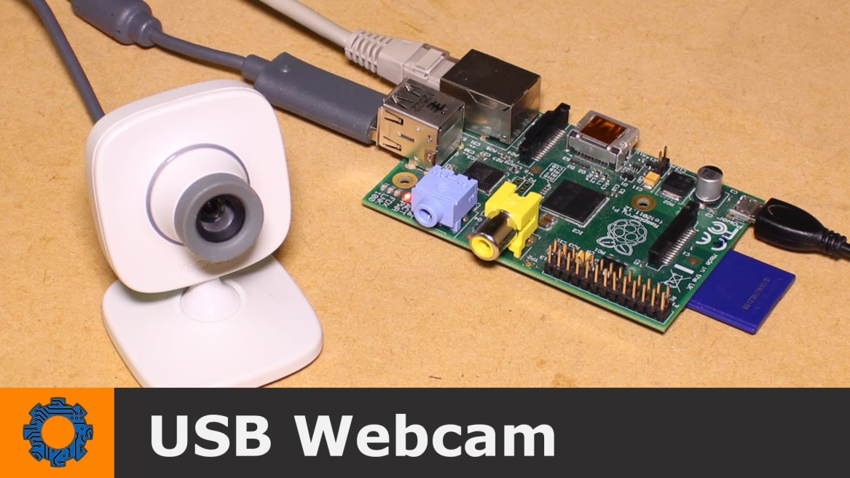
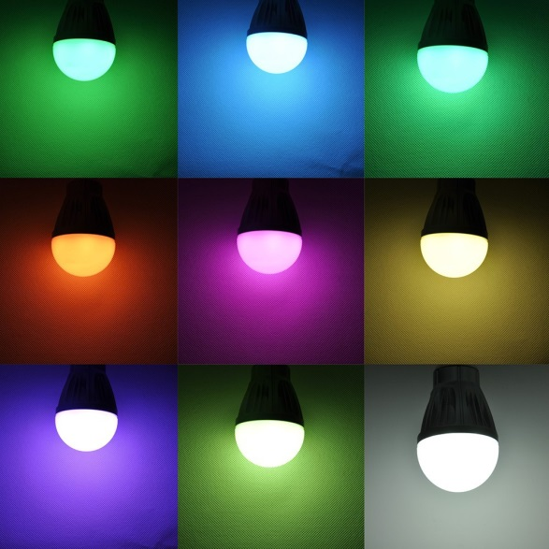
Long Term Plan

Slide 6
Why Machine Learning?
Project requirements might change in future
Include audio
Add more color options
Add functionality for other devices
Data may change
New camera
New desk location ➔ new lighting conditions

Slide 7

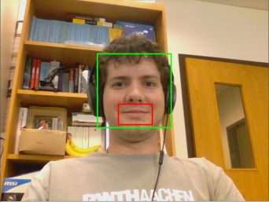

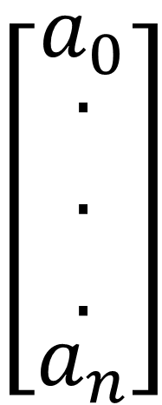
Implementation

Slide 8



Implementation
Viola Jones
Boosted Haar Cascade
Crop
(Unsupervised) Variational Convolution Neural Net Autoencoder
(Supervised) Recurrent Neural Net

Slide 9
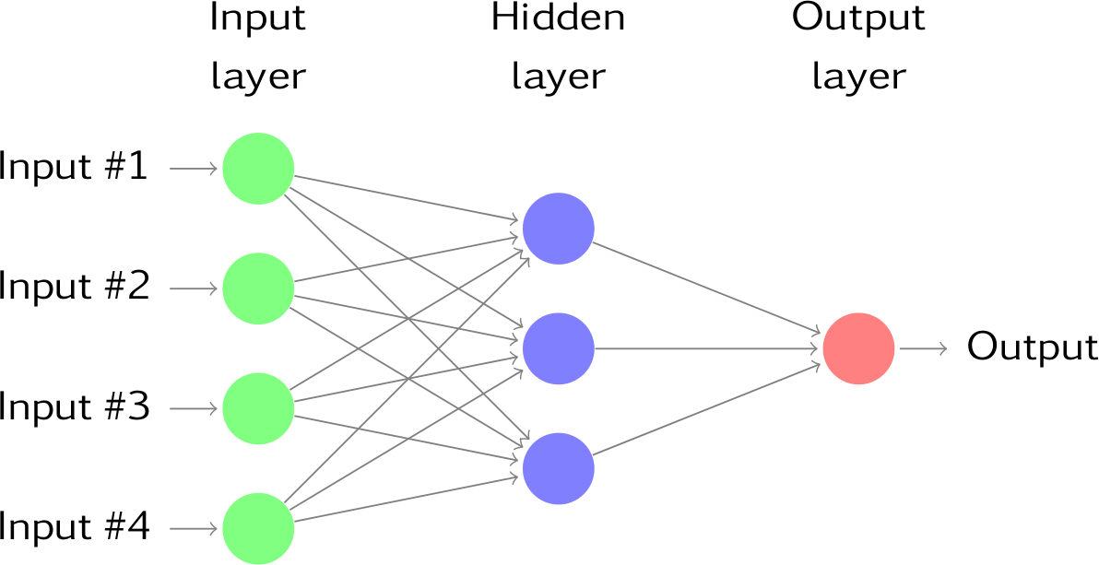
Variational Convolution Neural Net Autoencoder

Slide 10
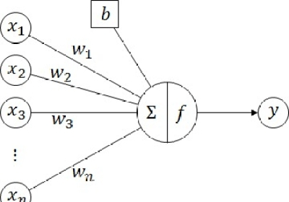
Neural Net

Slide 11
Neural Net can Implement Logic
Dark red color splotch
Vertical gradients on white/red boundary

Slide 12
Neural Net can Implement Logic
Dark red color splotch
Mouth is open
“and”
Vertical gradients on white/red boundary

Slide 13
Neural Net can Implement Logic
Dark red color splotch
Mouth is open
“and”
Vertical gradients on white/red boundary
Corners of mouth raised

Slide 14
Neural Net can Implement Logic
Image-wide and more abstract descriptions
Local Pixel-level
Information
Dark red color splotch
Mouth is open
“and”
Vertical gradients on white/red boundary
Corners of mouth raised

Slide 15
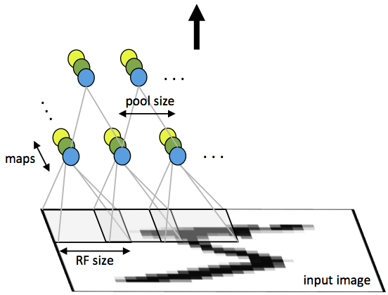
Variational Convolution Neural Net Autoencoder
Output
Hidden Layer
Input Layer

Slide 16
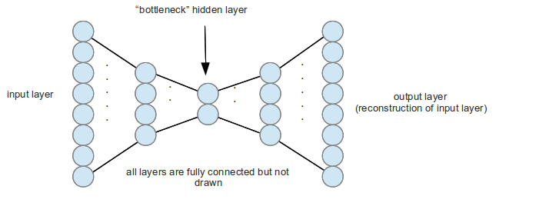
Variational Convolution Neural Net Autoencoder

Slide 17
Variational Convolution Neural Net Autoencoder
Encode
Decode

Slide 18

Variational Convolution Neural Net Autoencoder
$$\sim N\left(0,1\right)$$

Slide 19
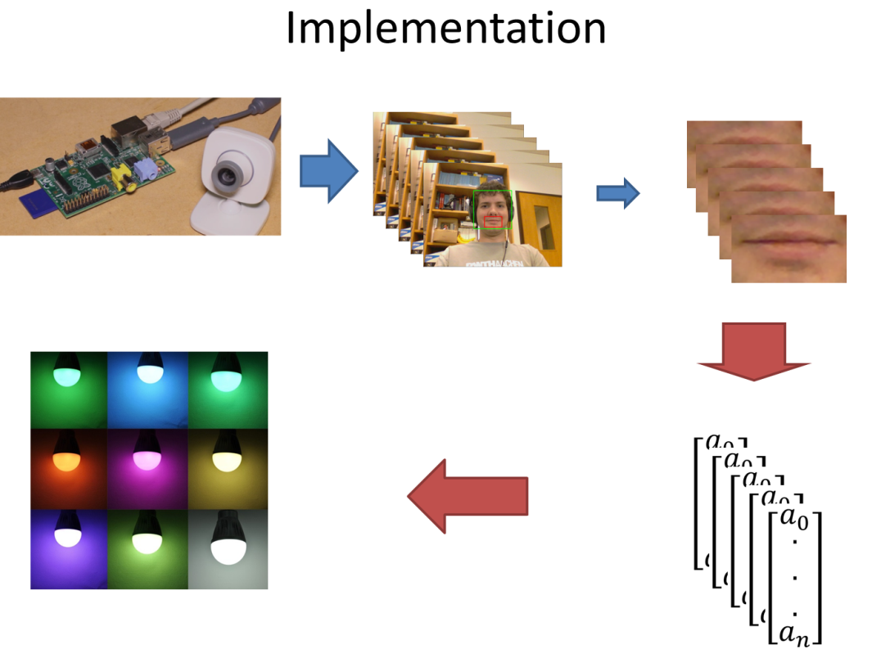
Step 1: Detect and Crop

Slide 20

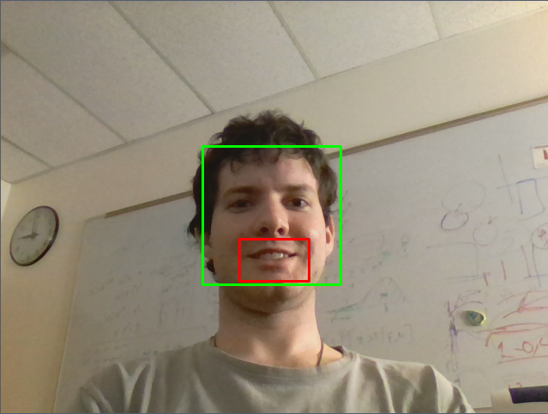
Step 1: Detect and Crop
Even Lighting
(easy)
Uneven Lighting
(difficult)

Slide 21

Step 2: Encode
Encode
Decode

Slide 22
Training (Variational Autoencoder)
20,000 images (32x32x3) taken during Skype conversations
11,966,848 parameter model
500x as many parameters as independent inputs!
Only 20mil pixels in training set!
Projected 7 months for model to converge on modest laptop cpu
~14 hours on TACC gpu

Slide 23
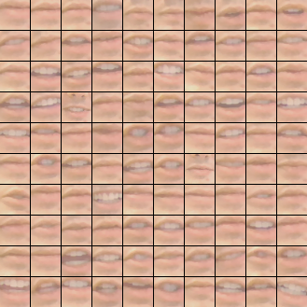

Training
Original
“Reconstructed”
Encode
Decode

Slide 24

Training: 300epoch (6mil iter) later…
Original
“Reconstructed”
Encode
Decode

Slide 25
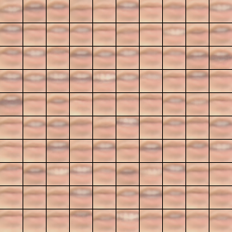

“Variational” Convolution Neural Net Autoencoder:
Allows for generation of new images, which is nice
Algorithm Imagined or “Hallucinated” images

Slide 26
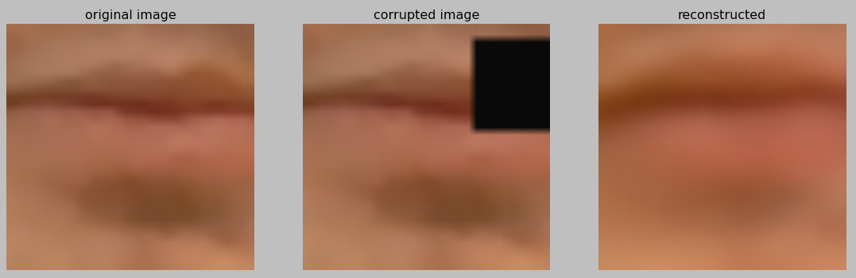
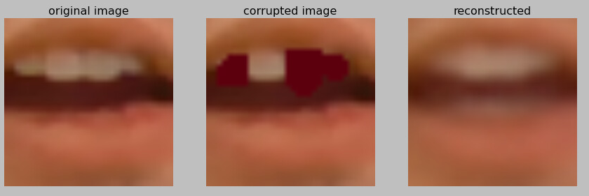
Just for fun: Image Inpainting and Artifact correction
Encode
Decode

Slide 27

Step 3: Predict Color with vector sequence

Slide 28
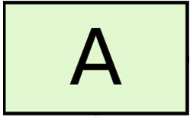
Recurrent Network
“ ”
Represent a single layer neural network
Let
http://colah.github.io/posts/2015-08-Understanding-LSTMs/

Slide 29


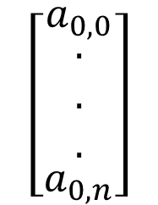

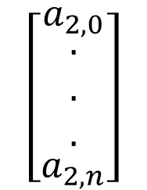
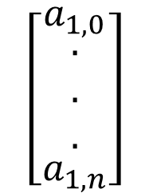
Recurrent Network
Color Prediction
$$\left[\begin{matrix}a_{0,0} \\ \begin{matrix}. \\ . \\ .\end{matrix} \\ a_{0,n}\end{matrix}\right]$$
$$\left[\begin{matrix}a_{1,0} \\ \begin{matrix}. \\ . \\ .\end{matrix} \\ a_{1,n}\end{matrix}\right]$$
$$\left[\begin{matrix}a_{2,0} \\ \begin{matrix}. \\ . \\ .\end{matrix} \\ a_{2,n}\end{matrix}\right]$$
$$\left[\begin{matrix}a_{t,0} \\ \begin{matrix}. \\ . \\ .\end{matrix} \\ a_{t,n}\end{matrix}\right]$$
http://colah.github.io/posts/2015-08-Understanding-LSTMs/

Slide 30
Recurrent Network
Model motivation: pass on a “memory” vector of output of previous frames to influence how the next frame is interpreted
Color outputs { red, purple, yellow }
Purple is similar to two syllables of red
Yellow could potentially be predicted by a single wide-mouth frame alone
http://colah.github.io/posts/2015-08-Understanding-LSTMs/

Slide 31
Recurrent Network: training
~300 training examples of each color
903 total
16-25 time points each example (variable!)
512 dim vector “code” for each frame
A modest 2,099,200 variables
Training takes ~1hr (gpu)
Randomly choose 90%/10% split :
803 for training : 90 for testing
http://colah.github.io/posts/2015-08-Understanding-LSTMs/

Slide 32
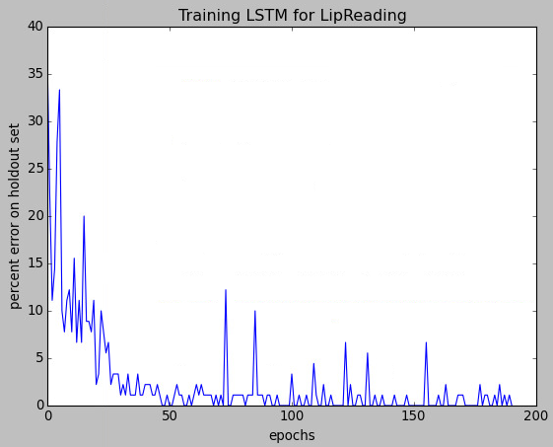
A Surprise! A Perfect Classifier
Quickly achieve 0% error on both training and test set (all colors)
Rare feat in computer vision
Probably would not be flawless with 10x more examples

